Slide 1

Sentiment analysis in social network messages
School of information and comunication technology
Member:
Nguyen Van Quoc : 20214926
Vu Tung Linh

Slide 2
Contents
About dataset
EDA and Data processing
Model
Evaluation
Conclusions
For more info: Github: baeyuki/NLP20241PRJ (github.com)

Slide 3
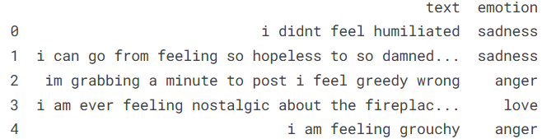
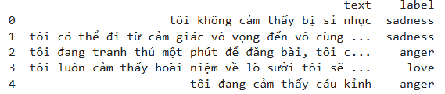
Dataset
Our dataset is a collection of Twitter messages and their sentiment labels. The original data is in English, however for the purpose of working with Vietnamese we have used deep_translator to translate into Vietnamese.
Disadvantages of the dataset: Using a translator leads to a lack of diversity because one English word can be represented by many Vietnamese words. For example, I in English is synonymous with the words tớ, mình, tao, ...
Deep_translator

Slide 4
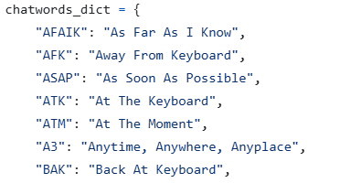
EDA and Data processing
1. Translation
Chat words: Acronyms are often used in chat sentences for brevity. We need to process them to make the translation into Vietnamese more accurate. We create a chatwords_dict and replace these chat words with their correct form before translating into Vietnamese to have a dataset for model training.

Slide 5
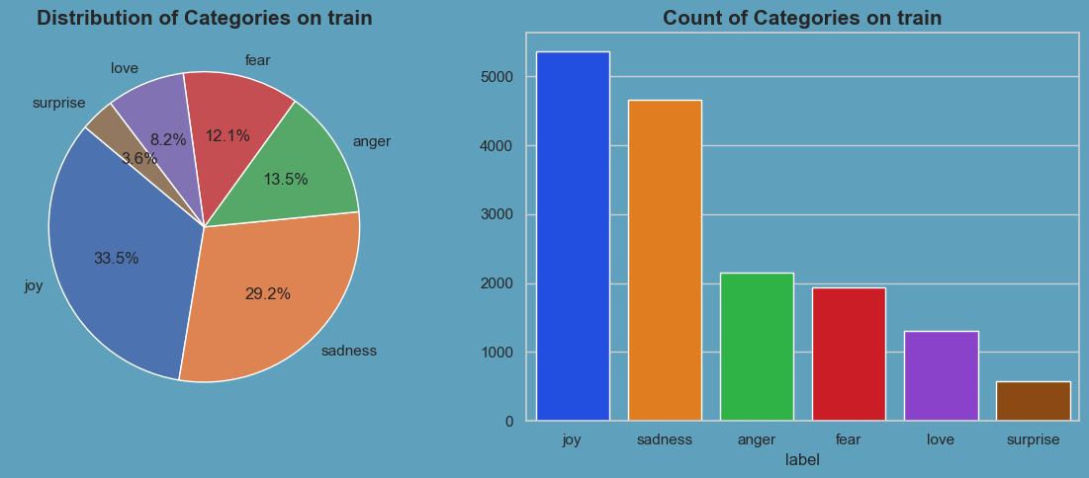
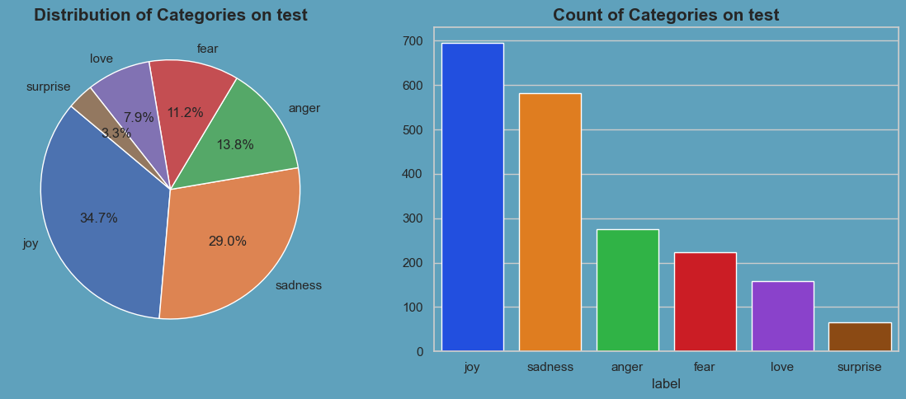
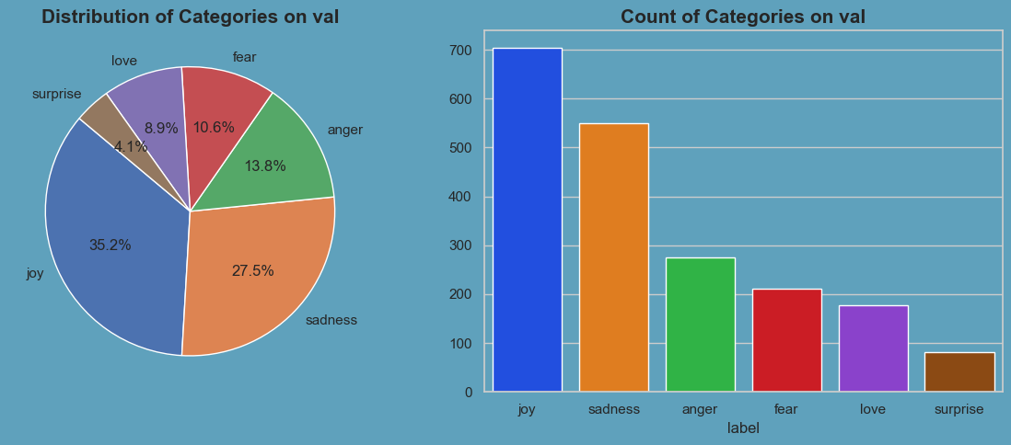
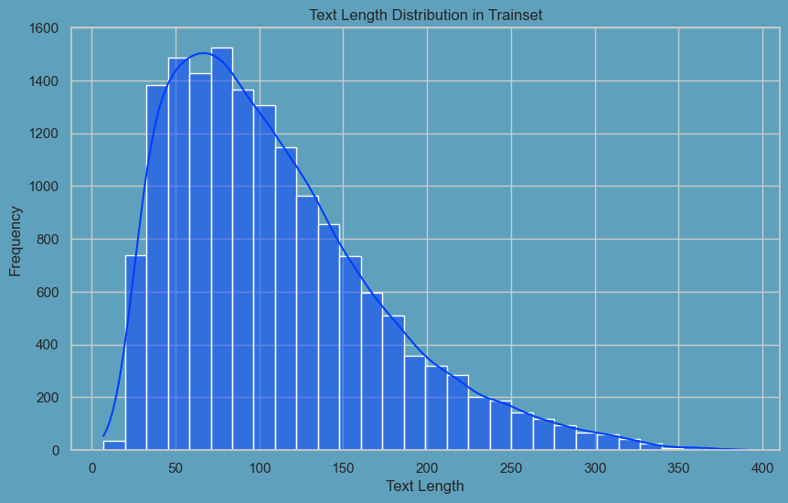
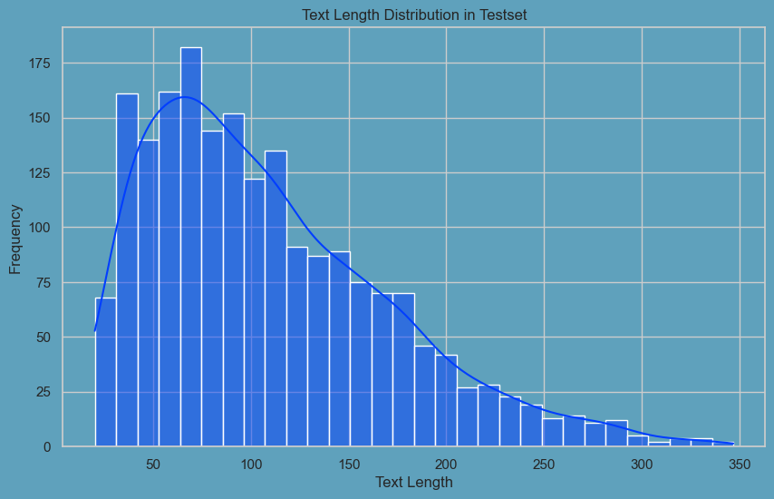
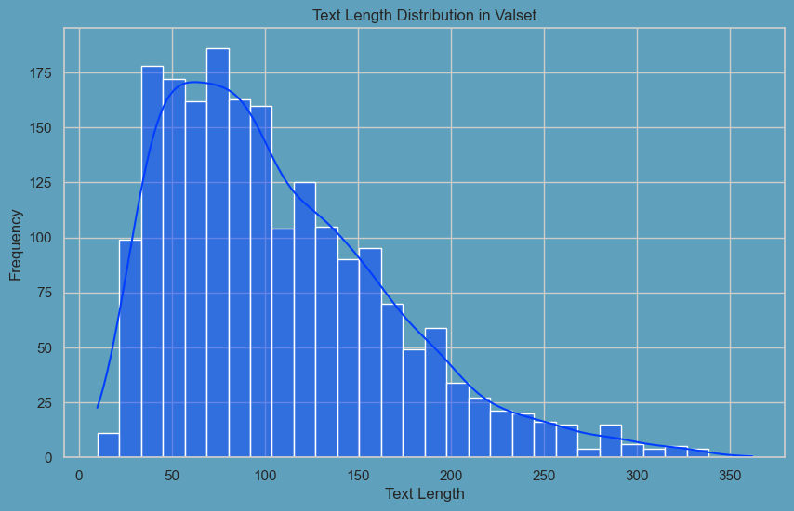
EDA and Data processing
2. EDA
Looking at the chart, we can see that the distribution of labels and text length is quite uniform in all 3 sets of train, test and validation, which has a good impact on the performance of the model.

Slide 6
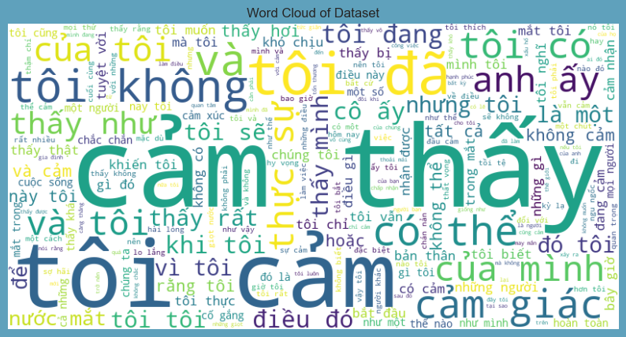
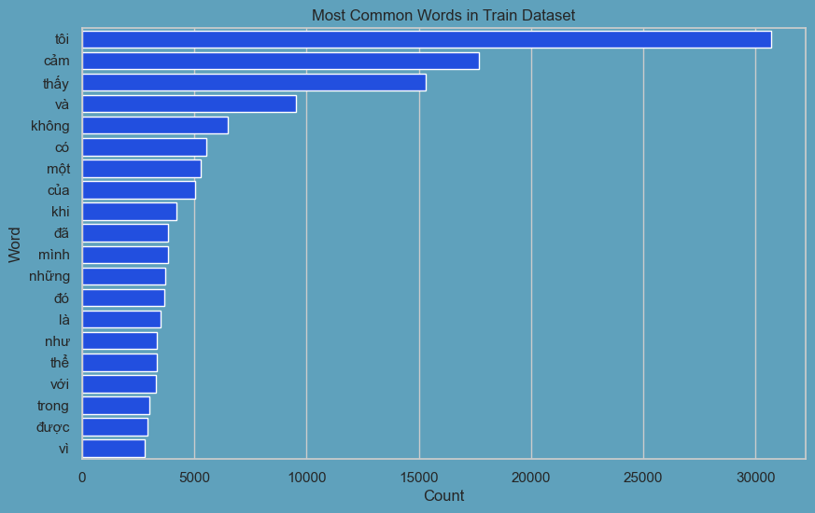
EDA and Data processing
2. EDA
We can see these words appear a lot in the data

Slide 7
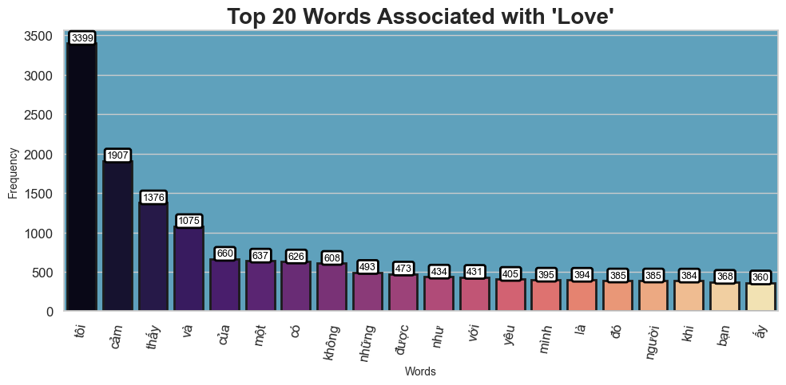
EDA and Data processing
2. EDA
I draw a table showing the 20 most appearing letters for each label. Through this we can see that there are letters that appear a lot in all labels to consider removing them during the training process.

Slide 8
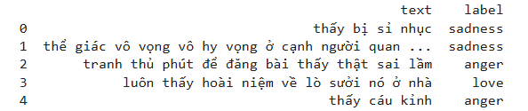
EDA and Data processing
3. Processing
For the obtained data set, we begin to perform the preprocessing steps:
We use the re library to perform the actions:
- Delete white space
- Delete numeric characters
- Delete special characters
- Delete urls
- Delete marks
Stop words are common words like "tôi", “là", "và", etc., which are often filtered out from text data.
Removing them helps the model focus analysis on important words, improving results, while reducing data size, ...

Slide 9
04
Model

Slide 10
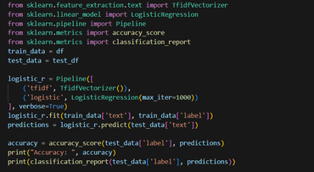
Model
I built 3 models for this task: logistic regression and BiLSTM
I use df to train and test_df for test model
Logistic regression
This model uses Path from scikit-learn, which combines TfidfVectorizer for feature extraction with a LogisticRegression classifier. TfidfVectorizer converts text data into TF-IDF features, recording the calculated term frequency According to the inverse document frequency, the LogisticRegression model, with a maximum number of iterations set to 1000, is then trained to classify text sentiment based on these characteristics such as accuracy, f1 score printed for review.

Slide 11
Model
II. BiLSTM
Vocabulary
-> I create a Vocabulary class with main functions
- Manages and provides mappings between words and indices in a dictionary.
- Adds a new word to the dictionary and returns its index.
- Tokenize documents into lists of words and normalize them.
Convert lists of words (tokenized corpus) into tensors of indices.
2. MessageDataset
-> I built a MessageDataset class in PyTorch to prepare data for the model. The main function is to convert text and label data from text and string to tensor form, using the previously built Vocabulary. This helps during the training process, the data can be used effectively by representing it as digital data that the model can understand and process.

Slide 12
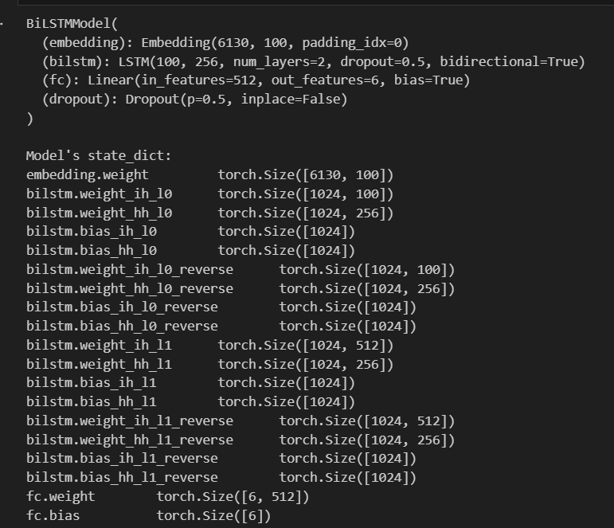
Model
II. BiLSTM
3. Model
I use pytorch to build a BiLSTM model with the following structure
Parameter:
OUTPUT_DIM = 6
INPUT_DIM = len(vocab)
EMBEDDING_DIM = 100
HIDDEN_DIM = 256
PAD_IDX = vocab["<pad>"]

Slide 13
Model
III. PhoBERT
We use PhoBERT_base_transformers from hugingface to train the model, the trained model has the following structure:
Because PhoBERT is designed for Vietnamese, I will not preprocess before training the model
word_embeddings: Embedding(64001, 768, padding_idx=0)
position_embeddings: Embedding(258, 768, padding_idx=0)
token_type_embeddings: Embedding(1, 768)
LayerNorm: LayerNorm((768,), eps=1e-05, elementwise_affine=True)
dropout: Dropout(p=0.1, inplace=False)
attention: RobertaSelfAttention
intermediate: RobertaIntermediate
output: RobertaOutput
classifier: RobertaClassificationHead

Slide 14
05
Evaluation

Slide 15
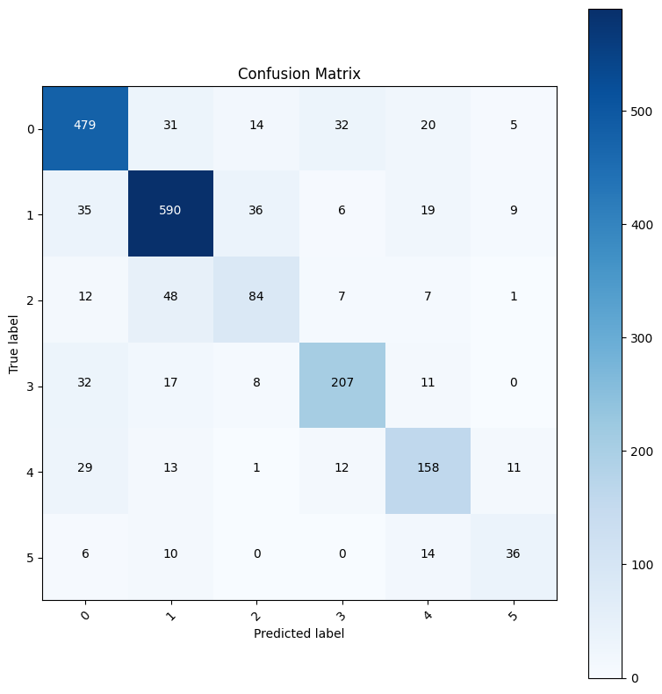

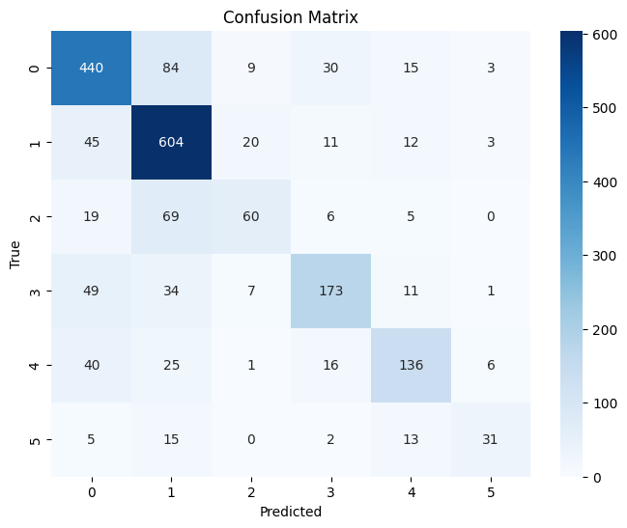
Evaluation
Confusion matrix
Logistic regression(acc: 0.722) BiLSTM (acc: 0.77) PhoBERT (acc: 0.82)

Slide 16
06
Conclusions

Slide 17
Conclusions
In general, the models achieve quite good results if properly tuned, however, due to limitations of the data set, when translated from Vietnamese to English, it will not be able to cover the leading Vietnamese contexts. to errors in the model, we will try to handle the data problem in the future so that the model is trained in the best state. In general, the most effective is still PhoBERT because this is the model built for Vietnamese, the remaining models like BiLSTM or Logistic regression are quite good for the problem of emotion classification.

Slide 18
Thank you!

